Slide 1

Credit Card User Segmentations
Team 7: Kunpeng Huang, Yoki Liu, Lyufan Pan, Yunlei Zhou, Jiayuan Zou, Sherry Zuo

Slide 2
Business Objective
1

Slide 3
Business Objective
Building specialized marketing strategies for different user segmentations Data Business Plans
The number of user segmentations?
What are their characteristics?

Slide 4
Data Exploration
2

Slide 5
Data Exploration
Data Exploration:
18 variables (Balance, Credit Limit, Purchase, Cash Advance, Installments, %Full Payments, Frequencies, etc)
8950 observations
Data Cleaning:
Remove Customer ID
Replace Minimum Payment NAs with mean

Slide 6
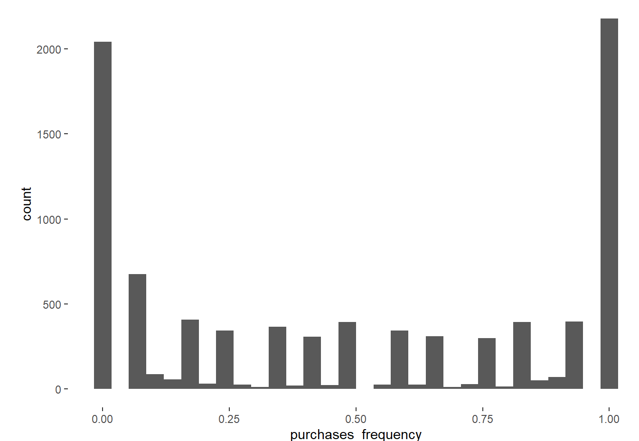
Data Exploration
Fun Facts
Purchasing frequency polarization
Not big fans of using installment payment method
43.7% of cardholders are inactive (frequency = 0 ) on using installments payment methods
Majorly used in the daily life for not expensive items
The mean of maximum purchase amount did in one-go is $592

Slide 7
Analysis Methodology
3

Slide 8
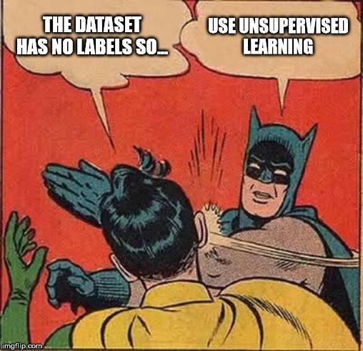
Analysis Methodology
Unsupervised ML -- Clustering
Simple K-means
K-means with dim. Reduction (t-SNE)
K-means with dim. Reduction (PCA)

Slide 9
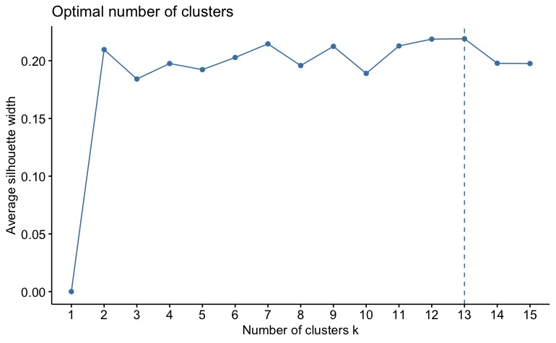
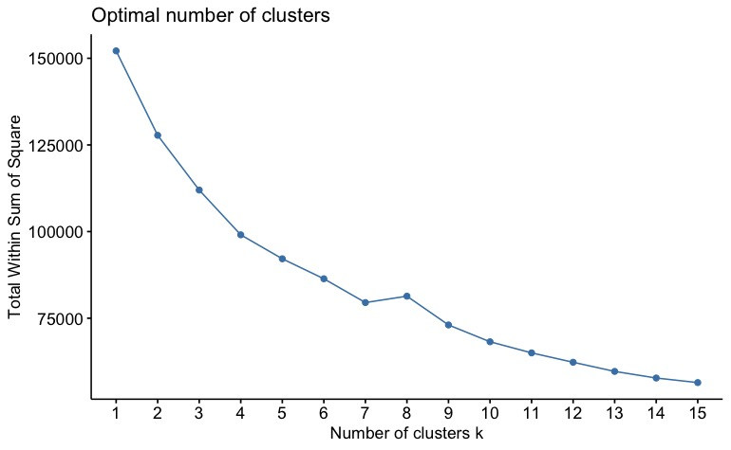
K-means Baseline Clustering Model
With 9 clusters
cluster | 1 | 2 | 3 | 4 | 5 | 6 | 7 | 8 | 9
size | 624 | 1997 | 884 | 1179 | 1119 | 356 | 24 | 2730 | 37

Slide 10
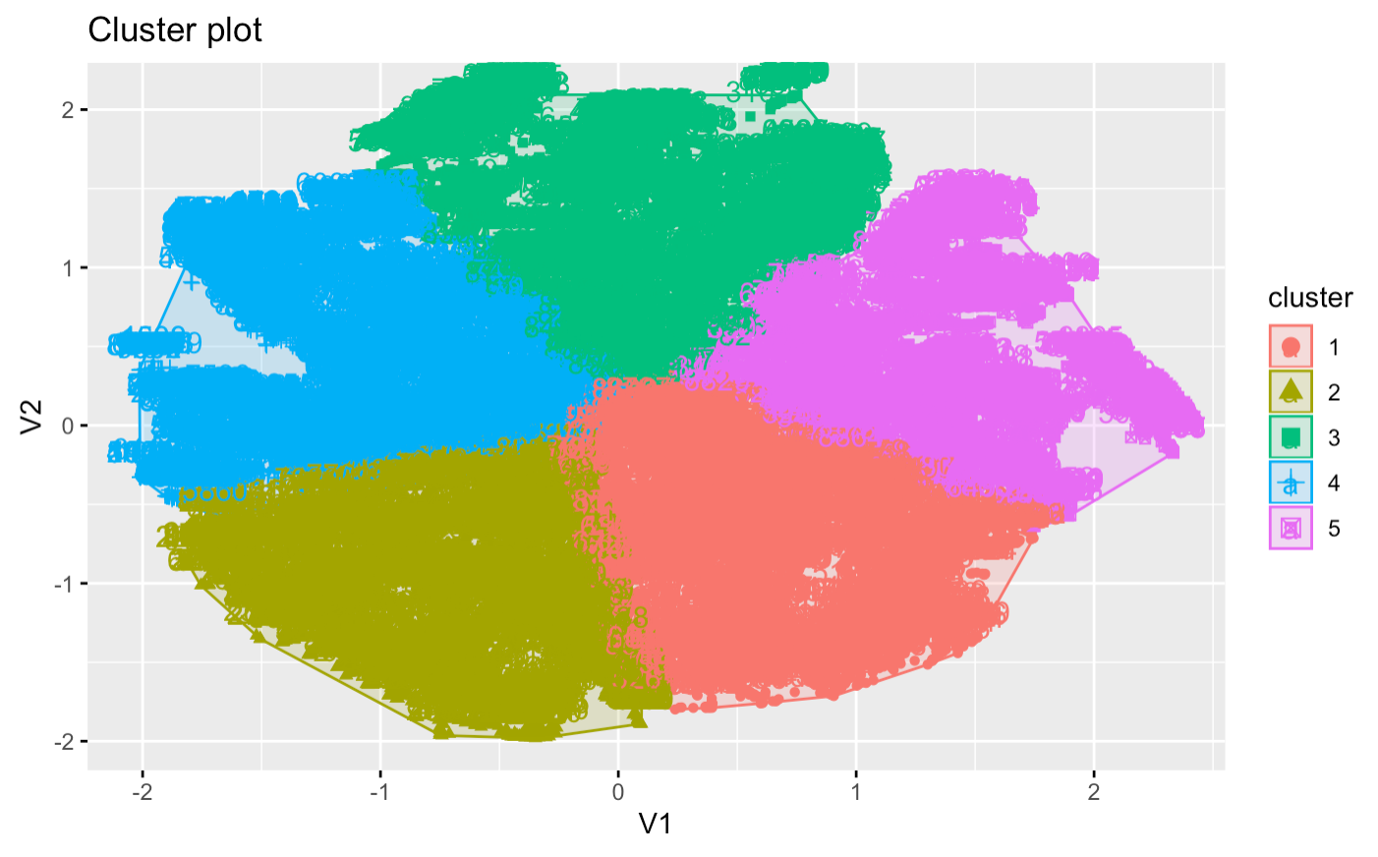
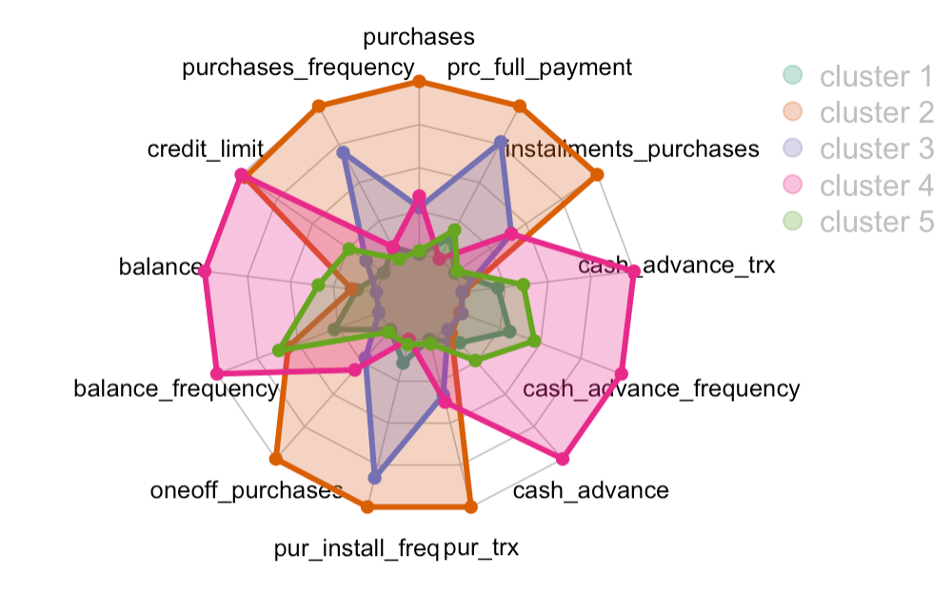
K-means Clustering Model with Dimension Reduction (t-SNE)
Try with 4 ~ 8 clusters in two-dimensional space
Here is the example of the result with 5 clusters

Slide 11
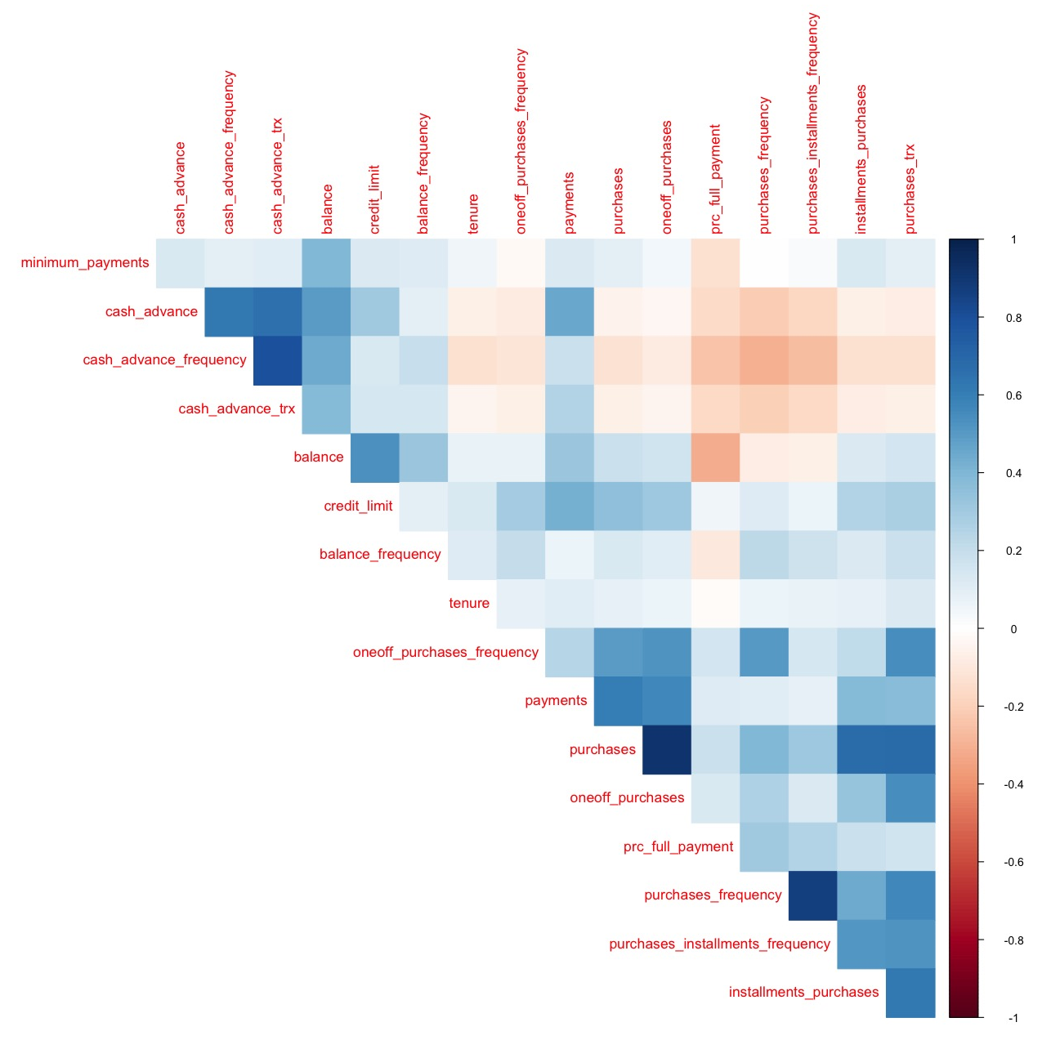
Variable Correlation
3 ~ 5 groups with high correlations

Slide 12
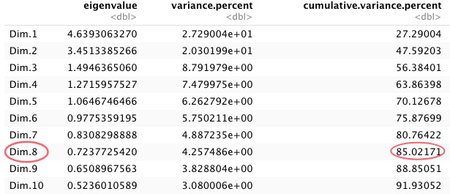
K-means Clustering Model with Dimension Reduction (PCA)
Var.% > 85%
8 Dimensions

Slide 13
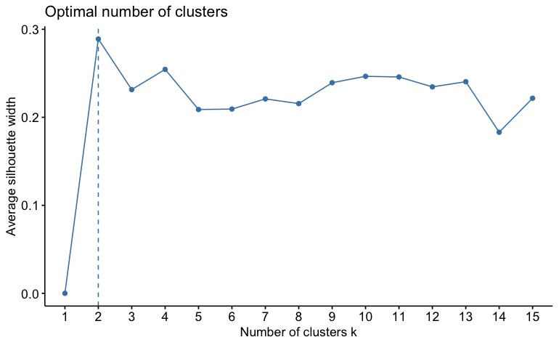
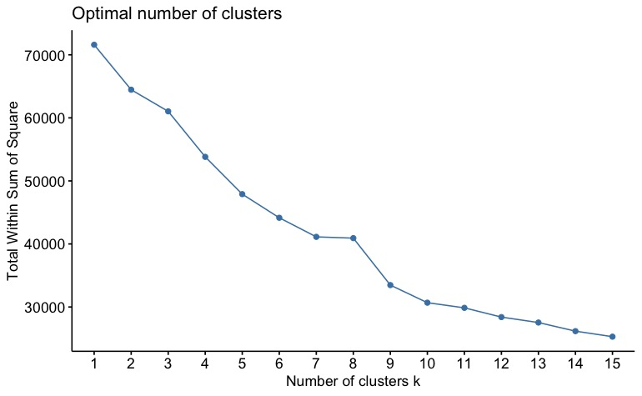
K-means Clustering Model with Dimension Reduction (PCA)
Silhouette Score: cluster of 2
WSS: cluster of 2, 5, 7, and 9

Slide 14
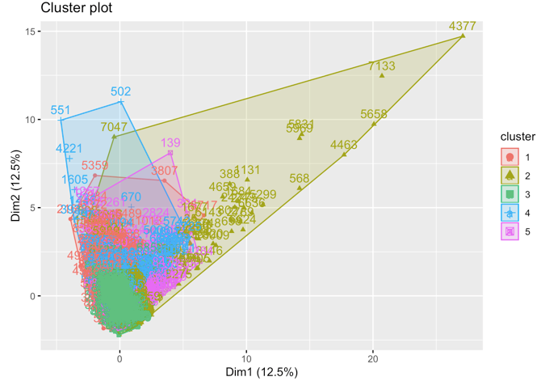
921
1224
727
3878
2200

Slide 15
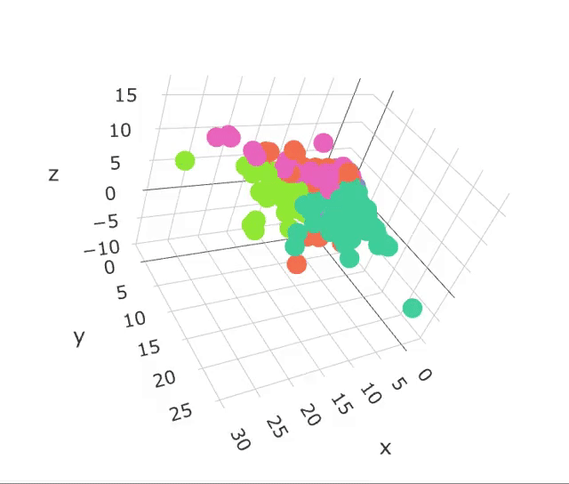
K-means Clustering Model with Dimension Reduction (PCA)
3D Visualization of 5 clusters
(3 out of 8 dimensions)

Slide 16
User Evaluation
4
Exploration Boxplots
Visualization Radar chart

Slide 17

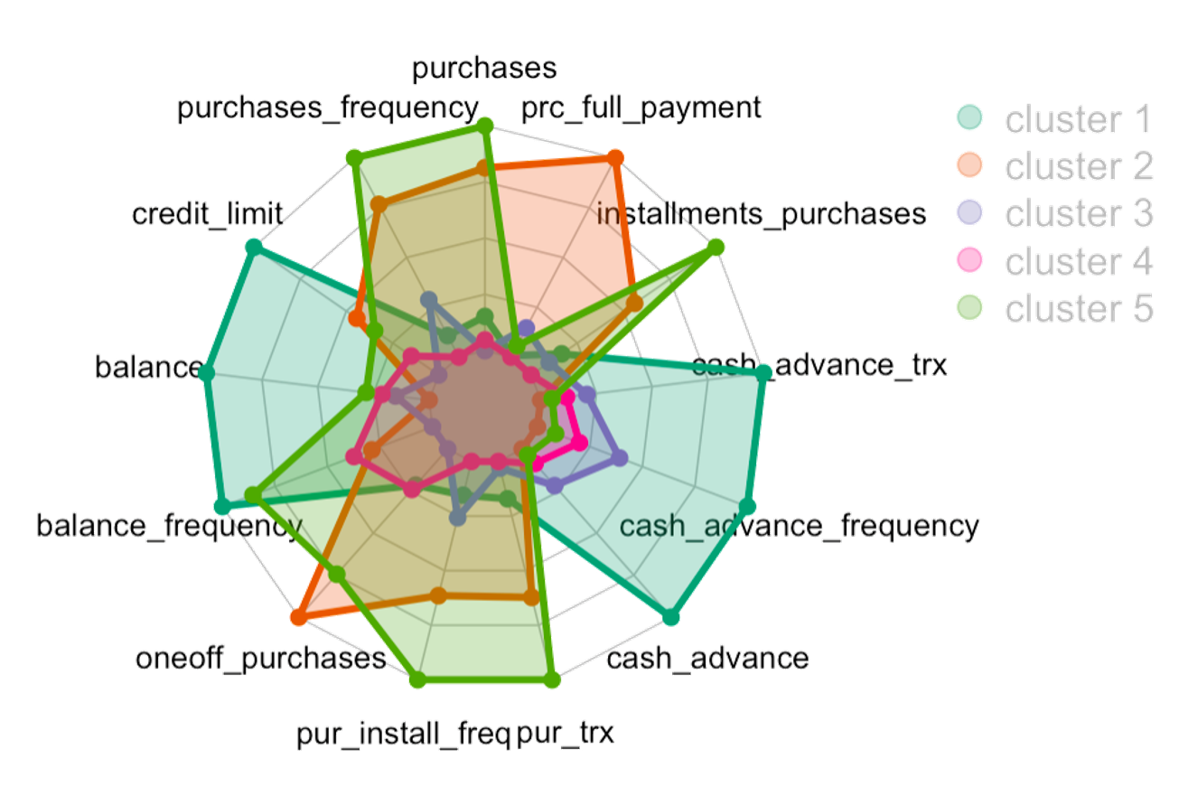

Slide 18
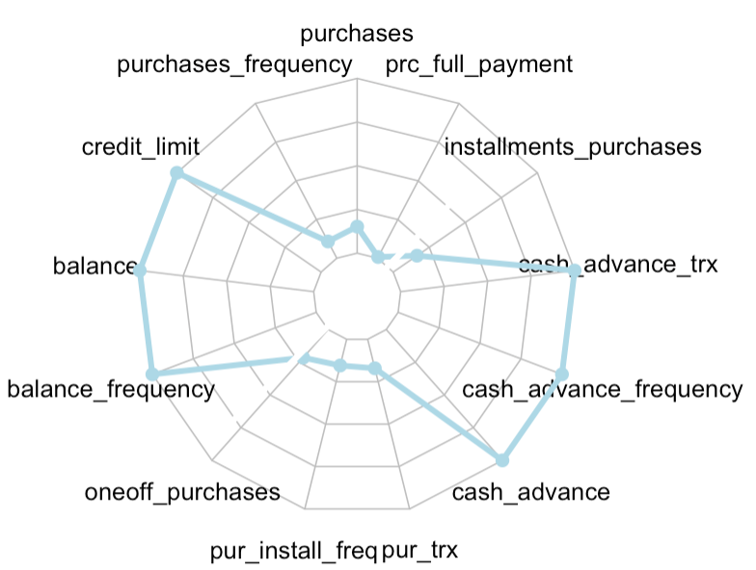
Cluster 1 💳
Long-time users for daily purchases
high credit $5,000-$8,500
high balance $2,000-5,500
low purchase $0-$700
no installment
high cash advance $1,150-$1,750
Notes:
Customers in cluster1 that use credit cards for small purchases and daily purchases are usually very economical and will be attracted by adding on benefits.

Slide 19
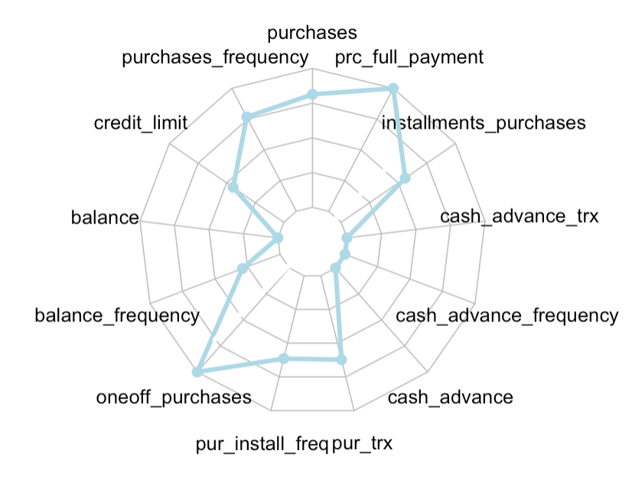
Cluster 2 💳
Users live from paycheck to paycheck
median credit $2,000-$6,000
low balance < $200
high purchase $300-$1,500
high frequency
high installment $100-$800
no cash advance
high full payment
Notes:
Having policies like earning a certain amount of bonus points after the customer spends $3,000 on purchases in the first three months from account opening, and that allows them to redeem the points for shopping, travel, or etc. Furthermore, if the customers spend more on traveling, we can also have policies like $300 annual travel credit as reimbursement or double points on travel expenses. Customers in cluster 2 with high spending behaviors care more about their living quality and are willing to spend money on enjoyment.

Slide 20
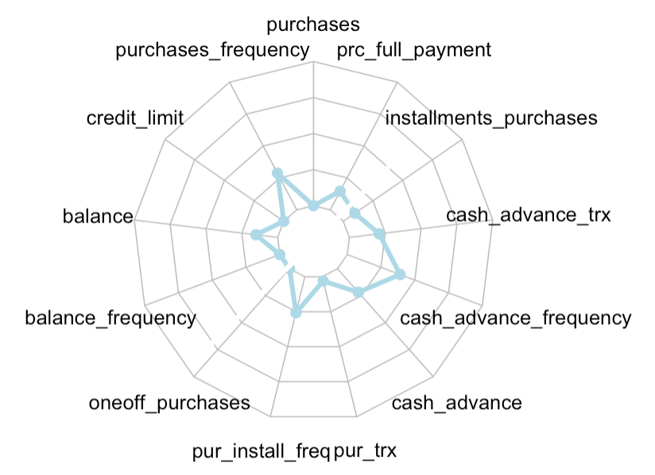
Cluster 3 💳
New card users
low credit < $2,000
medium balance $0-$1,500
low to med purchase $0-$760
low frequency
low installment < $250
low cash advance < $500
Notes:
The majority of the new card users are students and targeting their own spending interest will be a good way to make them forming the habits of using credit cards.

Slide 21
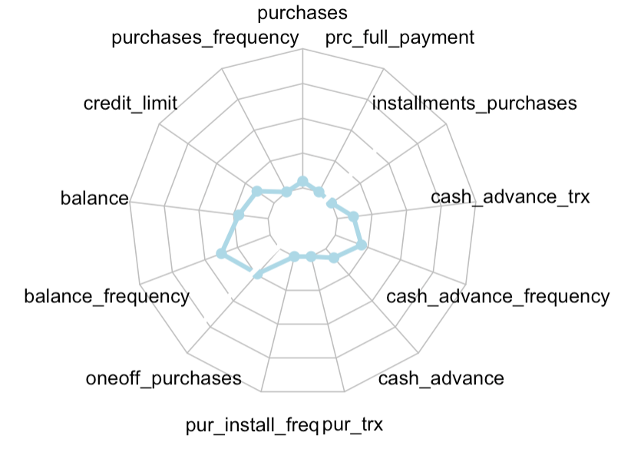
Cluster 4 💳
Inactive cardholders
low credit $2,000-$4,000
medium balance $200-$1,800
Low purchase < $500
the least frequency
low installment
low cash advance < $500
Notes:
Generalize a comprehensive credit card to target inactive cardholders. People don’t use credit card that often might prefer to use debit cards to prevent from spending too much money or have lots of credit cards to choose from. An all-sided credit card may quality their needs and attract them to use our credit card more often than the others. Customers in cluster 4 is difficult to perceive and offering all-sided strategy will be an appropriate way to target them.

Slide 22
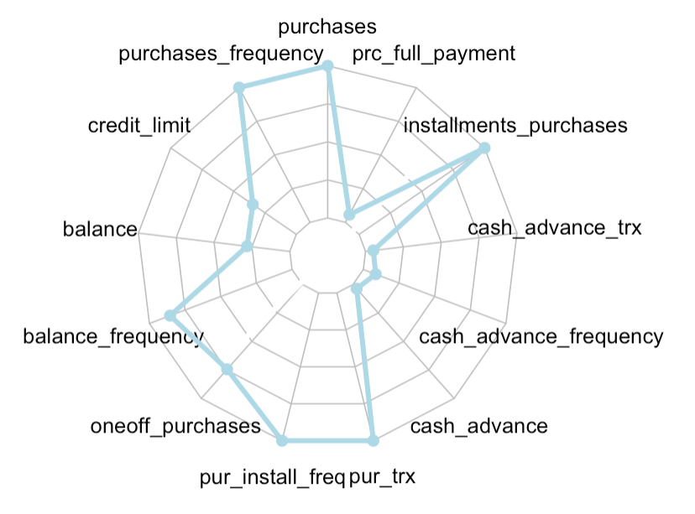
Cluster 5 💳
Installment users with high spending behavior
medium credit ~ $3,000
medium balance ~ $1,000
the highest purchase ~ $1,000
high frequency
high installment $250 ~ $1,000
low cash advance
low full pay back
Notes:
The majority of the new card users are students and targeting their own spending interest will be a good way to make them forming the habits of using credit cards.

Slide 23
Marketing Strategies
5

Slide 24

Cluster 1 💳
Long-time users for daily purchases
Generalize cashback focused credit card
unlimited 1% cash back
up to a certain amount in combined purchases in bonus categories (like gas stations, grocery stores, etc.) each quarter
Notes:
Customers in cluster1 that use credit cards for small purchases and daily purchases are usually very economical and will be attracted by adding on benefits.

Slide 25
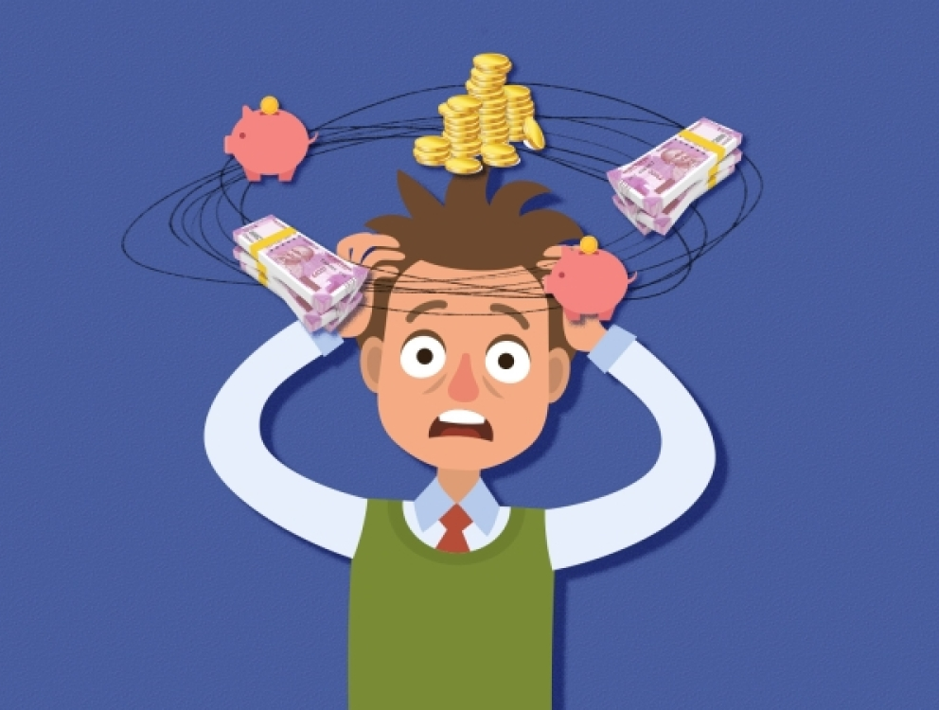
Cluster 2 💳
Users live from paycheck to paycheck
Generalize bonus point focused credit card
with certain annual fee
bonus point after spending $3,000 in the first three months
annual travel credit as reimbursement
double points on travel expenses
Notes:
Having policies like earning a certain amount of bonus points after the customer spends $3,000 on purchases in the first three months from account opening, and that allows them to redeem the points for shopping, travel, or etc. Furthermore, if the customers spend more on traveling, we can also have policies like $300 annual travel credit as reimbursement or double points on travel expenses. Customers in cluster 2 with high spending behaviors care more about their living quality and are willing to spend money on enjoyment.

Slide 26

Cluster 3 💳
New card users
Generalize special incentives
sending out introduction mails
target them with “pre-approved”
offer 3% cash back on selected category and let the customers choose which category they would like to activate
Notes:
The majority of the new card users are students and young professionals ,targeting their own spending interest will be a good way to make them forming the habits of using credit cards.

Slide 27

Cluster 4 💳
Inactive cardholders
Generalize a more comprehensive card
no annual fee
free or low APR
unlimited 2-3% cash back on every purchase
Notes:
Generalize a comprehensive credit card to target inactive cardholders. People don’t use credit card that often might prefer to use debit cards to prevent from spending too much money or have lots of credit cards to choose from. An all-sided credit card may quality their needs and attract them to use our credit card more often than the others. Customers in cluster 4 is difficult to perceive and offering all-sided strategy will be an appropriate way to target them.

Slide 28

Cluster 5 💳
Installment users with high spending behavior
Generalize certain benefits with APR required
priority airport lounges, room upgrades, and special gifts for purchases
free APR for the first six months
free balance transfer
Notes:
The majority of the new card users are students and targeting their own spending interest will be a good way to make them forming the habits of using credit cards.

Slide 29
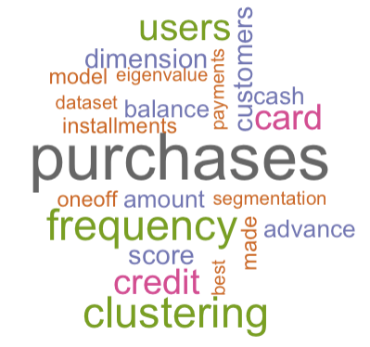
THANKS!
Any questions?

